Slide 1


Presentation
Mental health Tracker
Charan Sai Anche
2103A53001

Slide 2



INDEX
01 - Introduction
02 - Need
03 - Documentation
04 - Technology
05 - Implementation
06 - Conclusions

Slide 3

01 - INTRODUCTION
In today's fast-paced work environment, the mental wellbeing of employees is crucial for organizational success. However, detecting and addressing mental health issues in the workplace can be challenging.
Traditional methods rely heavily on self-reporting, which may not always be accurate or timely. To address this gap, our project focuses on implementing Facial Mental Tracking technology in organizations.

Slide 4

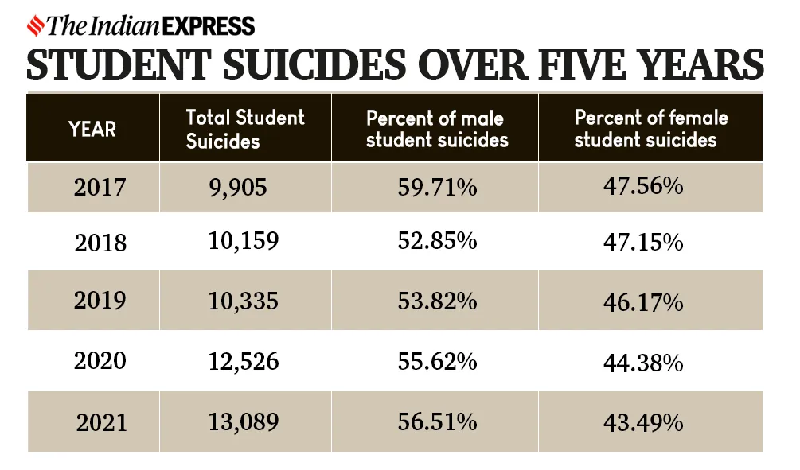
02 - DOCUMENTATION
Suicidal thoughts and behaviors are complex and multifaceted, often stemming from a combination of mental, emotional, social, and environmental factors. It's essential for individuals experiencing suicidal ideation to seek help from mental health professionals, friends, family, or support organizations. With proper treatment, support, and intervention, recovery and healing are possible.uicidal thoughts and behaviors are complex and multifaceted, often stemming from a combination of mental, emotional, social, and environmental factors. It's essential for individuals experiencing suicidal ideation to seek help from mental health professionals,

Slide 5

03 - NEED
"Anxiety is a real problem in our society"
Facial Mental Tracking enables early detection of mental health issues such as stress and burnout by identifying changes in facial expressions associated with these conditions. This early detection allows organizations to intervene promptly, preventing further escalation of mental health problems.
The implementation of Facial Mental Tracking technology addresses the critical need for proactive monitoring of employee mental health in organizations. By leveraging advanced technology to detect and address mental health issues early, organizations can foster a healthier, happier, and more productive workforce.

Slide 6

04 - TECHNOLOGY
KERAS:
High-level deep learning API for building and training neural networks.
Simplifies the process of creating complex models with minimal code.
CONVOLUTIONAL NEURAL NETWORKS (CNNS):
Specialized neural networks for image processing tasks.
Utilized for feature extraction from input images in the model architecture.
IMAGEDATAGENERATOR:
Keras utility for real-time data augmentation during training.
Facilitates diverse dataset creation through transformations like rotation and flipping.
OPENCV (CV2):
Open-source computer vision library for image processing.
Employed for webcam image capture and facial expression detection.
TENSORFLOW:
Backend engine for Keras, providing efficient computation for deep learning.
Handles low-level operations such as tensor manipulation and gradient computation.

Slide 7

05- IMPLEMENTATION
Facial Emotion Tracking systems analyze facial expressions in real-time, offering insights across industries like retail, healthcare, and education. By detecting emotional cues, organizations can tailor experiences and interventions effectively. This technology fosters deeper connections, drives positive outcomes, and holds promise for revolutionizing engagement strategies in various sectors.
"We need to learn to manage our emotions"
Furthermore, Facial Emotion Tracking contributes to the advancement of personalized experiences and improved outcomes. Whether it's optimizing marketing campaigns, refining educational approaches, or enhancing therapeutic interventions, the ability to understand and respond to individuals' emotional states in real-time enables organizations to foster deeper connections, drive positive behavior change, and achieve greater levels of satisfaction and success. With continued innovation and integration, Facial Emotion Tracking holds significant promise in revolutionizing how businesses, educators, healthcare providers, and entertainers engage with their audiences and deliver impactful experiences.

Slide 8

06 - CONCLUSIONS
"It is important to pay attention to our mental health"
Facial Emotion Tracking systems offer versatile applications and significant potential for enhancing understanding and engagement across industries. By harnessing the power of facial expressions to inform decision-making and optimize experiences, organizations can drive positive outcomes and revolutionize their approach to customer engagement and service delivery.

Slide 9

Thanks
Charan Sai Anche

